Slide 1
STUDENT MANAGEMENT SYSTEM
PROJECT MENTOR: MUKUNDHA SIR
T HRUTHIK REDDY (17311A1263)
L ABHINAY (17311A12A7)
V VENKATESH (17311A12A8)

Slide 2
CONTENTS
ABSTRACT
INTRODUCTION
MODULES
SYSTEM REQUIREMENTS
EXISTING SYSTEM
PROPOSED SYSTEM
UML DIAGRAMS
OUTPUT OF PROJECT
BENEFITS
DRAW BACKS
CONCLUSION

Slide 3
ABSTRACT
Student Management System is software which is helpful for college as well as the school authorities. In the current system all the activities are done manually.
It is very time consuming and costly. Our Student Management System deals with the various activities related to managing student records. Our Objective is computerizing the process of student records management.

Slide 4
INTRODUCTION
This project is aimed to automate the student management system. This project is developed mainly to administrate the student records. The purpose of the project entitled as to computerize the FrontOffice Management of student records in colleges, schools and coaching’s, to develop software which is user friendly, simple, fast and cost-effective. Traditionally, it was done manually .The main function ofthe system is to register and store student details, retrieve and these details as and when required, and also to manipulate these details meaningfully.

Slide 5
MODULES
ADD NEW STUDENT RECORD
UPDATE EXISTING STUDENT RECORD
DELETE STUDENT RECORD
SEARCH STUDENT RECORD BY ROLL NO,NAME,DATE etc..,
SHOW ALL STUDENTS RECORD
EXPORT THE STUDENTS RECORD INTO A FILE
EXIT THE WNDOW

Slide 6
SYSTEM REQUIREMENTS
HARDWARE REQUIREMENTS
System with Windows/Ubuntu Operating System.
RAM preferably >2 GB

Slide 7
SOFTWARE REQUIREMENTS
PYCHARM IDE
MYSQL DATABASE
PYTHON INTERPRETER
LIBRARIES:
Pandas
Pymysql
Tkinter

Slide 8
EXISTING SYSTEM
All the student records are maintained manually in the schools and colleges. And student records are maintained in a single register or record book. So searching and updating the records are difficult to the staff management. And also there may be a chance errors. If the students increase year by year it is difficult to maintain so many register for the college. And if we want to send the data of students from one to another, it is difficult to send the information through the existing system.

Slide 9
PROPOSED SYSTEM
In proposed system , our system aims on the students information .The students information is entered in the system. And their information are recorded and stored in the database so that we can retrieve the data when even we want. And we introduced a export file in the student management system so that we can copy the information of the particular student and use his information. Now we can easily add a student information into the database and can easily search for a particular student. If we don’t need the information of a particular student we can delete the student information also.

Slide 10
ER DIAGRAM (ENTITY-RELATIONAL)
ID
NAME
Ph no
ADDRESS
MANAGES
ADMIN
STUDENT
GENDER
TIME
DATE
DOB

Slide 11
USE CASE
Use case diagram consists of use cases and actors and shows the interaction between them. The key points are:
The main purpose is to show the interaction between the use cases and the actor.
To represent the system requirement from user’s perspective.
The use cases are the functions that are to be performed in the module.
An actor could be the end-user of the system or an external system.

Slide 12
USE CASE DIAGRAM
Add Student record
Update student record
Delete student record
Search student record
ADMIN
STUDENT
Use case diagram between Admin and Student

Slide 13
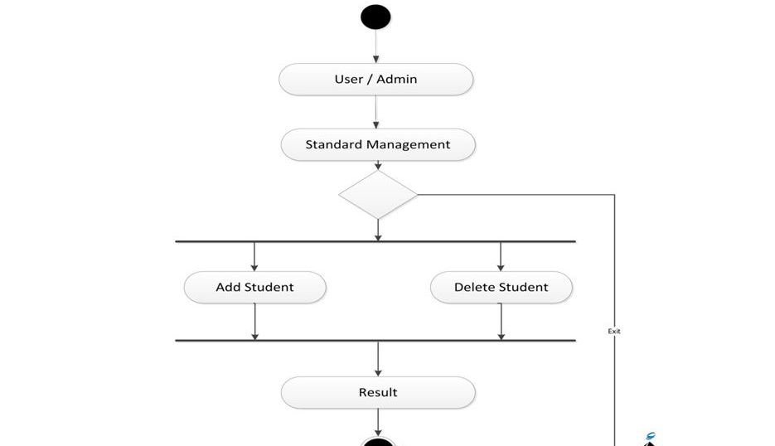
ACTIVITY DIAGRAM

Slide 14
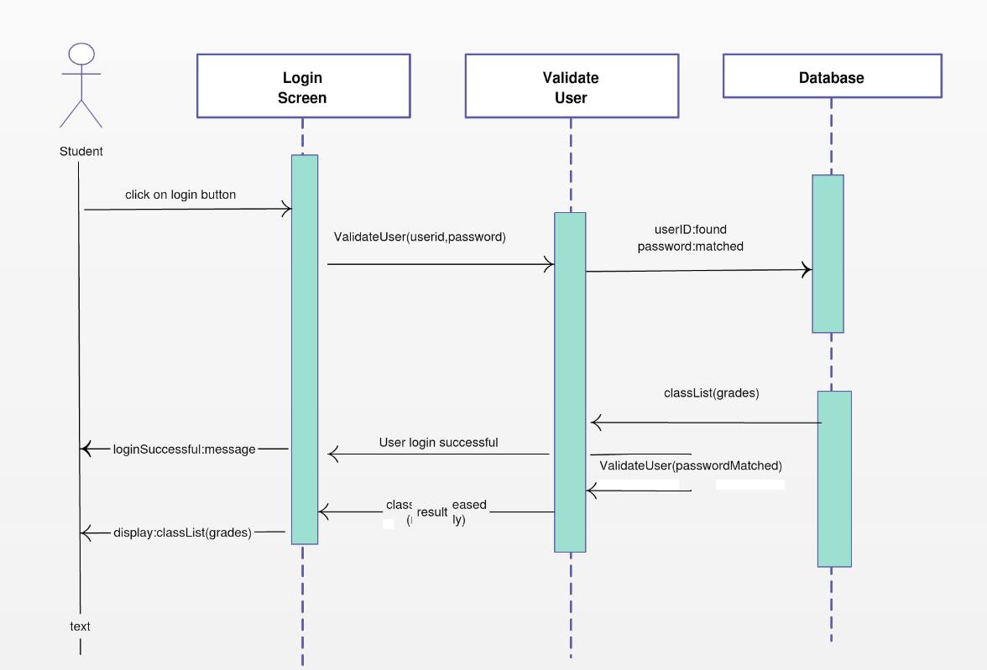
SEQUENCE DIAGRAM

Slide 15
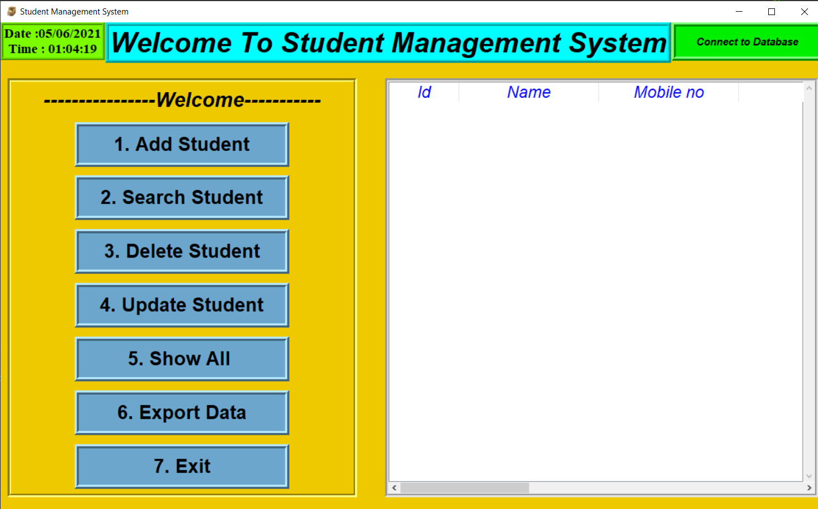
OUTPUT

Slide 16
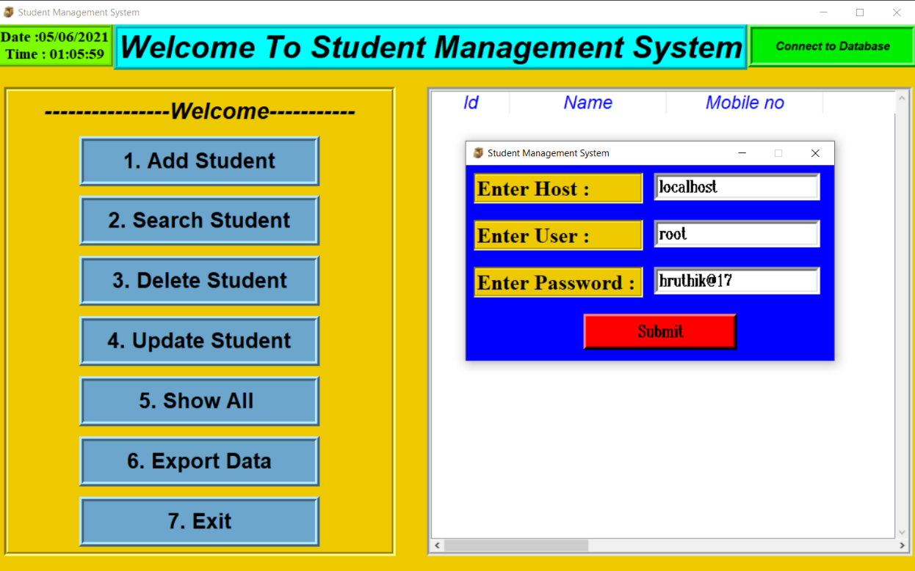
CONNECT TO DATABASE

Slide 17
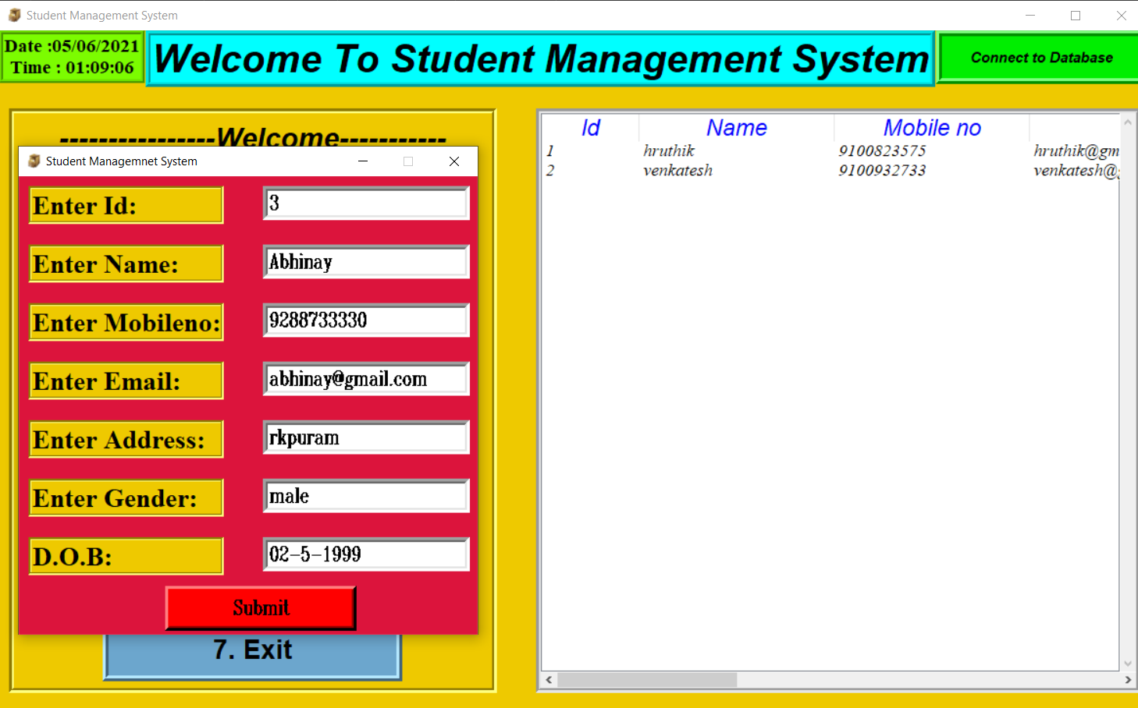
ADD STUDENT WINDOW

Slide 18
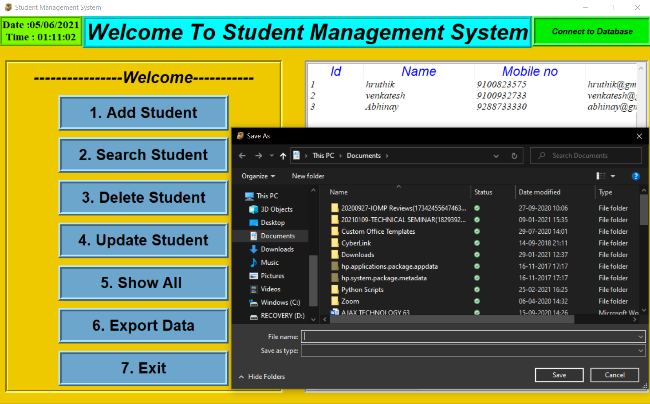
EXPORT TO FILE WINDOW

Slide 19
BENEFITS
Better Performance by Students.
Simplifying & Streamlining all Tasks.
Better Communication.
Easy Access to All.
Managing Timetables.
Complete Tracking of the Students.

Slide 20
DRAW BACKS
The drawbacks in Student Management System software can be counted on fingers; with mostly only benefits, these systems have a few countable downsides.
Often, applications face minor technical glitches and these systems are no exception but, ratification is immediate.
Only, people who are accustomed to regular use of smartphones or computers can operate this software.
Extensive modules and features make it difficult for a user to utilise the application. With huge flow in traffic the application is prone to performance issues.

Slide 21
FUTURE SCOPE
This Software can be made for all OS.
Higher Security features can be included in this software.
Program scheduling can also be included in this software.
This software can be developed to use as tutorial to teach basic concepts of OS to new users.
Automatic Shutdown through SMS service can be implemented in this.

Slide 22
CONCLUSION
The student management system is useful for all schools and colleges to maintain the data of their students his system helps in maintaining the information of pupil of the organization. It can be easily accessed by the manager and kept safe for a long period of time without any changes. In future this could be enhanced in so many ways to keep their data safe and secure

Slide 23
THANK YOU

